Slide 1
PARCC Score Reports
Presentation
Presented by:
Greater Brunswick Charter School
December 2, 2015

Slide 2
What will we discuss today?
What are the primary objectives of the PARCC Assessment System?
What changes have been made to PARCC testing since last year?
How are the assessments scored?
What will the student report look like?
What do teachers/parents need to know about the score reports?
What resources are there for teachers/parents?
Notes:
So let’s talk about PARCC, as it was in spring 2015. As a reminder, PARCC was given to all students in English language arts in grades 3-11, all students in math grades 3-8, and students enrolled in Algebra 1, Geometry, or Algebra II.

Slide 3
PARCC 2015
Notes:
So let’s talk about PARCC, as it was in spring 2015. As a reminder, PARCC was given to all students in English language arts in grades 3-11, all students in math grades 3-8, and students enrolled in Algebra 1, Geometry, or Algebra II.

Slide 4

What are the primary objectives of the
PARCC Assessment System?
Determine whether students are college- and career-ready or “on track”
Provide tools to assess student learning and support instruction during the school year
Report growth in performance as well as absolute achievement
Report comparable results across schools, districts and member states
Generate valid and reliable information to inform instruction and accountability decisions
Use technology for a range of purposes including increasing student access, providing accommodations, engaging students, and creating efficiencies in administration, scoring and reporting
Notes:
Listed here are the stated objectives of the PARCC assessment system. It is referred to as a system because there are optional pieces in PARCC that can be used throughout the school year by teachers in an ongoing way. I do want to expand on a few of these points for clarification. The term “college and career” ready has been thrown around a lot the past few years. The PARCC assessment is designed to assess student mastery of the Common Core State Standards which were designed with higher education partners to reflect what students entering post-secondary institutions needed to be able to do to perform at the college level without taking any remedial courses. In New Jersey, the community colleges have pledged that students who demonstrate what PARCC deems college-ready performance will not have to take remedial courses upon enrollment and will not have to take any other placement tests in English language arts or math. The goal of reporting growth will not be realized until parents see a second year of PARCC scores for a child. Unlike NJASK, PARCC tests are built on the same scale in all grades so that you can directly compare results from year to the next. If you’ve seen my annual assessment accountability presentation in the past, you know that one of the challenges is always explaining why a cohort of students rises or falls dramatically from one year to the next. The new assessment system should fix that issue. One of the questions that has come up in my conversations with teachers and parents has been about how we will use PARCC results. Like any other standardized test, we will use them as one piece of a much larger puzzle. We will react to the results but we will not overreact. I am hopeful that we will get useful information about the strengths and weaknesses of our curriculum, instructional approaches, etc. and about where students are excelling and where they need some additional support.

Slide 5
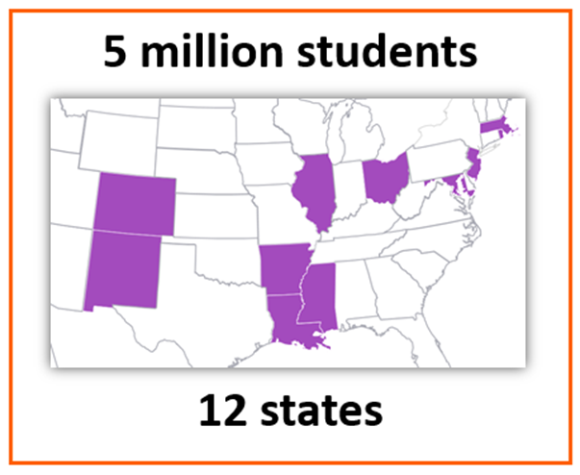
Test Administration in 2015
Key Stats
1.2 million students in one day
204,000 students in one hour
Peak: 1million testers per day x 5 days
Thousands of hours contributed by thousands of educators to develop the test
Notes:
PARCC administration last year was the single largest common state assessment ever given. In addition to a new test and procedures, this was the first time that large scale standardized testing was done on computers in New Jersey. We led the PARCC consortium with 99% of students completing the assessment on a computer. This will only get easier as we continue our Chromebook roll-out. I would also point out that New Jersey educators, including me personally, have been asked to participate in development of the assessment - from question design, to instruction manuals, to feedback about implementation.

Slide 6
PARCC 2016
Notes:
That feedback has led to some adjustments for PARCC implementation this school year.

Slide 7
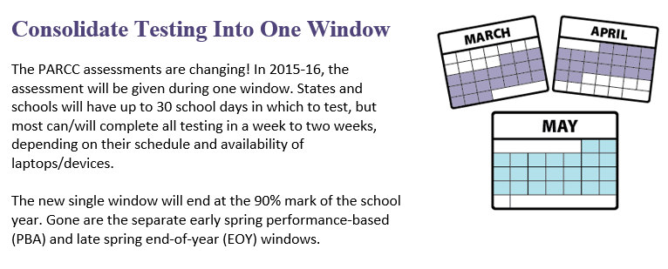
Test Design Changes – One Testing Window
Notes:
First, there will only be one PARCC window this year. Combined with our ability to test more grades at a time due to the Chromebook roll-out, this change will allow us to significantly decrease the impact on the school day. The state of New Jersey gives us a window in which we can test: that window for 3-8 is April 4 through May 13 and for 9-12 is April 11 through May 20.

Slide 8
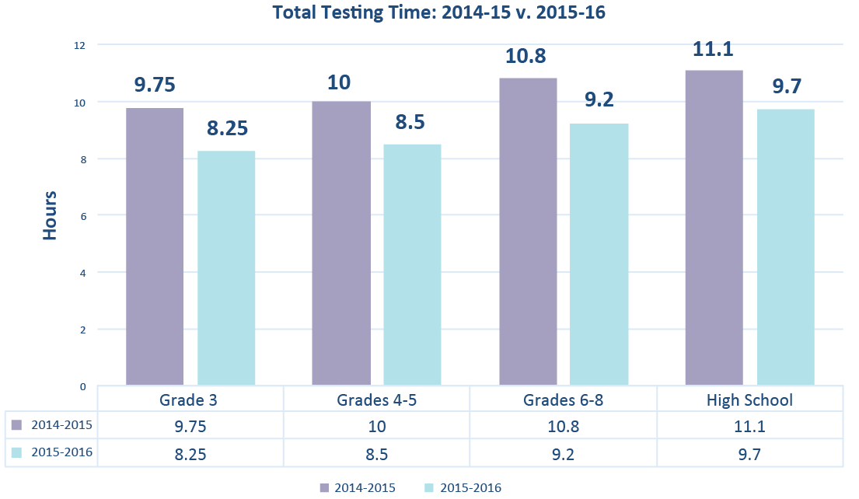
Test Design Changes - 90 Minute Reduction
Overall times include Reading/Writing and Mathematics across all test units per grade
Notes:
The adjustments to the test will reduce testing time by about 90 minutes in all grade levels with the new range being anywhere from 8.25 hours for third grade students to 9.7 hours for high school students. Keep in mind that those hours will be spread across 5-7 days.

Slide 9
Score Release - 2015 Only
State results - Late October
District results - Late November
Student results - Early December
Notes:
So with the background, let’s get to preparing for score reports. Late in October, the NJDOE release very broad state-level results. By the end of November, we will receive the same kind of broad district-level results followed shortly by the individual student score reports. Please note that this delayed timeline has been known all along as a one year necessity with a new assessment system. We are told that next year we will have PARCC results by July, a little earlier than we used to get NJASK results, and in time to use them as part of our decision-making processes for the following school year. My goal tonight is to introduce you to what those score reports will look like so that when they start coming home, there’s a bit of background in place.

Slide 10
What Parents and Teachers Need to Know About the Score Reports
The PARCC tests replace the old state tests. They measure how well students are performing against the new state standards that guide math and English language arts instruction.
The PARCC tests are only one of several measures, including Progress Summary grades and in-class performance, that are used to determine a student's academic achievement. The PARCC tests do not impact a student’s Progress Summary.
The score reports are a valuable tool for parents and teachers. The report provides a deeper level of information that can be used to better understand where students are doing well and where they need additional support. This helps teachers and parents support students.
Notes:
PARCC replaced NJASK and HSPA and represents only one measure of how students are performing relative to the state standards. The goal of the score report that goes home to parents is that it will serve as a useful tool for supporting children at home and for communicating with teachers. The PARCC tests replace the old state tests. They measure how well students are performing against the new state standards that guide math and English language arts instruction.
The PARCC tests are only one of several measures, including Progress Summary grades and in-class performance, that are used to determine a student's academic achievement. The PARCC tests do not impact a student’s Progress Summary.
The score reports are a valuable tool for parents and teachers. The report provides a deeper level of information that can be used to better understand where students are doing well and where they need additional support. This helps teachers and parents support students.

Slide 11
What Parents and Teachers Need to Know About the Score Reports
The PARCC tests moves away from multiple choice questions to ones that allow students to demonstrate a real understanding of what they know and can do by writing essays, solving real world problems, and reading and analyzing complex text—all critical skills in the real-world.
Your child’s score may look lower this year because the tests measured more complex skills. A low score does not mean your child did not improve or learned less, but instead that the expectations have been raised for students.
The first year’s scores are a new baseline from which we can measure progress moving forward.
Notes:
You can go back to previous presentations I’ve made about PARCC or the resources shared in the most recent issue of A Walk in the PARCC to see the types of questions asked and the level of sophistication required from students. In some ways this sentence is a little misleading because it suggests that there won’t be multiple choice questions. In fact, there are some, but there are also much more advanced questions that could not be asked the same way on a paper-based test. Some of you with older children may remember when the NJASK literacy assessment was changed, around 2007 or when the calculation method for graduation rate was changed a few years ago. In both cases, the expectations were raised and there was a temporary drop in scores. This does not necessarily mean performance went down; it means that expectations went up. This is where I talk about reacting but not overreacting and considering PARCC results in the context of all the information we have about student learning.

Slide 12
Five Performance Levels
Five Performance Levels
PARCC uses five performance levels that delineate the knowledge, skills, and practices students are able to demonstrate:
Place a purple frame around images
Level 1:
Did Not Yet Meet Expectations
Level 2: Partially Met Expectations
Level 3: Approached Expectations
Level 4:
Met Expectations
Level 5: Exceeded Expectations
Notes:
PARCC uses five performance levels, as you can see here. PARCC considers levels 4 and 5 as being on track for success in college and career where students have fully met the expectations of the standards for the grade level or course. By moving to 5 levels from the 3 NJASK used, we anticipate getting much more specific information about how students are doing at the ends of the continuum - including for our strongest students who often maxed out the NJASK assessment.

Slide 13
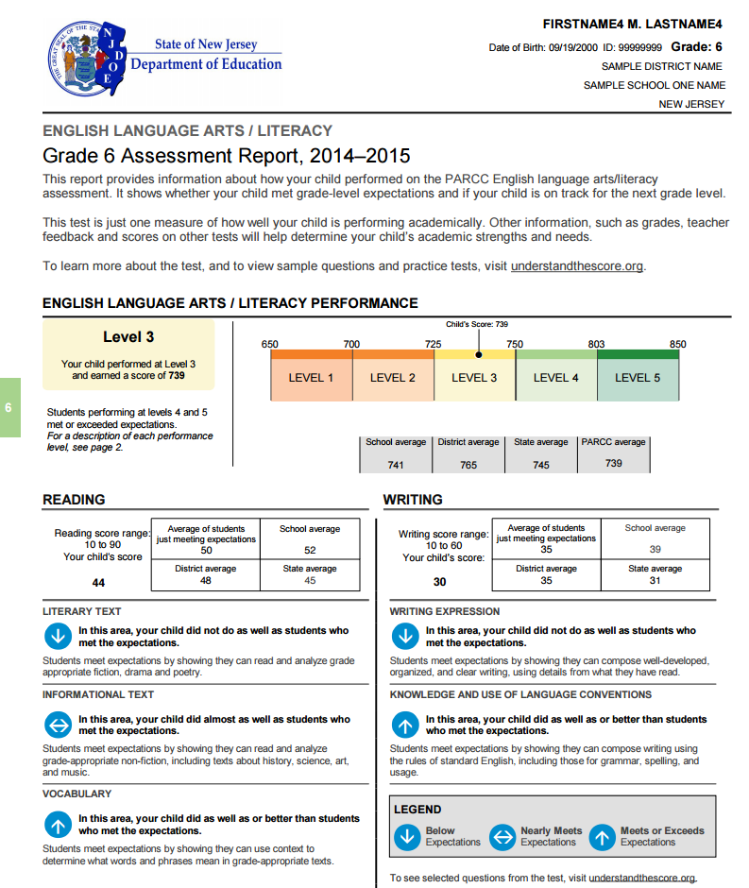
Five
Notes:
Now I’d like to walk you through a sample score report to give a sense of what you will be looking at when it arrives home. There were copies of the Parent Guide to the PARCC Score Report at the table when you arrived, which may be helpful to follow along with as I walk through it up here.

Slide 14
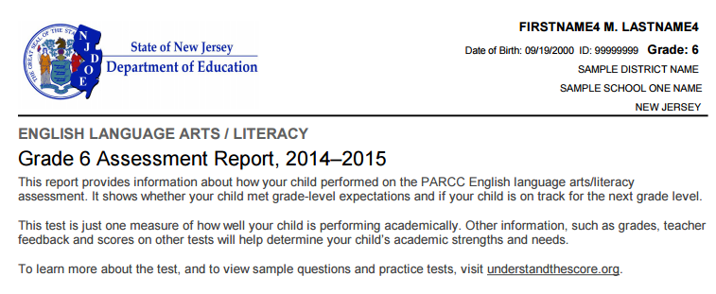
Five Performance Levels
Notes:
I will point out a few pieces of information for each section. First, the header to the score report document includes a link to a website that has a wealth of resources for parents that will grow even more robust over time. I’d like to draw your attention to the second section though - and I know I’m harping on this - but react not overreact. It says right on the test results that this is one measure of a child’s performance and should be considered within a larger context.

Slide 15
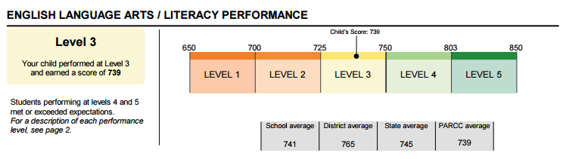
Five Performance Levels
Notes:
This section shows an overall numerical score on a 650-850 scale and a performance level based on that scale. You’ll notice that there is also comparable information to school, district, state, and PARCC consortium to give you a sense of where your child’s performance is relative to other children who took the same test.

Slide 16
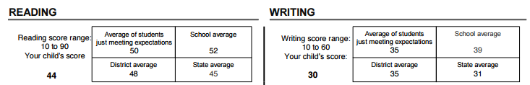
Five Performance Levels
Notes:
The report for English language arts also includes overall performance in the two main subcategories - reading and writing. There’s an important, and sometimes hard to see at first glance, clarification about this section of the score report. Here, you can see your child’s score compared to the school, district, and state, just like the overall test. You can also see the average score of students who are considered to be just meeting expectations.

Slide 17
Five Performance Levels
Notes:
If we go back for a second. Just meeting expectations is a 750 or the lowest possible score to be at Level 4.

Slide 18
Five Performance Levels
Notes:
So what they are telling us is that the average student who “passed” was at a 50 on the reading test and a 35 on the writing test. Here’s how you compared. This is meant to assist parents in seeing how close students are to meeting expectations if they are not there already.

Slide 19
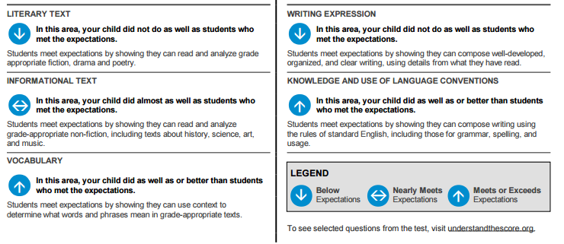
Five Performance Levels
Notes:
The detailed breakdown section then goes into even more detail about the specific skills to the content area. In English Language Arts, for example, this student is meeting or exceeding expectations in vocabulary and knowledge and use of language conventions, nearly meeting expectations in informational text, and below expectations in literary text and writing expression. Again, this is designed to give parents a simple visual cue to where a child’s relative strengths and weaknesses are.

Slide 20
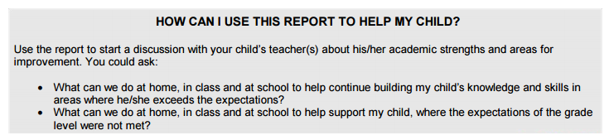
Five Performance Levels
Notes:
The score report also includes two questions that we should all be asking when we review results and I’m a really big fan of the way they are laid out. First and foremost - what can we do to continue building upon strengths? And then - how we do improve in areas that are not meeting expectations. I am hopeful that the way the score report breaks things down will help us celebrate the areas of strength, even for students who may be struggling, in ways that the NJASK reports did not really help us do.

Slide 21
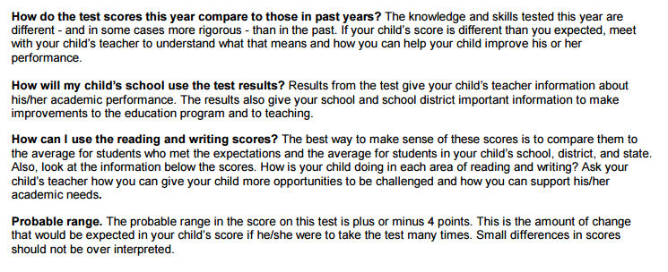
Five Performance Levels
Notes:
Finally, the back of the score report will also answer a couple basic questions that I think I’ve already addressed, but I want to bring your attention to “probably range” at the bottom. Unlike NJASK, PARCC is telling all of us front the margin of error for a student’s test performance. As we all know, performance can vary a bit from day to day, based on all kinds of environmental factors, or due to differences in the actual form of the test used. PARCC tells us that the probable range of a student’s performance is plus or minus 4 on the overall scale.

Slide 22
Five Performance Levels
Notes:
For a student with a score of 739, that means that the student is confidently performing in the 735-743 range. We should all be very careful to remember this statistical information when a child’s score is near a break point between levels. React, don’t overreact.

Slide 23
PARCC Resources:
Educators Resources
Parent Resources
Student Resources
Understanding the Score Report
Notes:
Links to these resources were emailed to the staff, along with this PPT.

Slide 24
PARCC Score Reports
Parent Presentation
Presented by:
Greater Brunswick Charter School
Notes:
I know that this may feel like a whirlwind introduction to a lot of information. Like I said at the outset, I am committed to doing everything in my power to make people feel as prepared as possible for the first PARCC results so I sincerely hope this has been useful to you. Thank you.

